Slide 1
Best complementary products
Ali awari

Slide 2
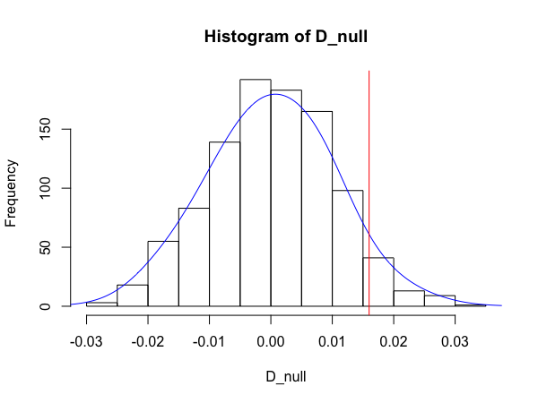
Soda + Steak
Purchasing soda & steak together has a permutation value of 0.047, which is below .05

Slide 3
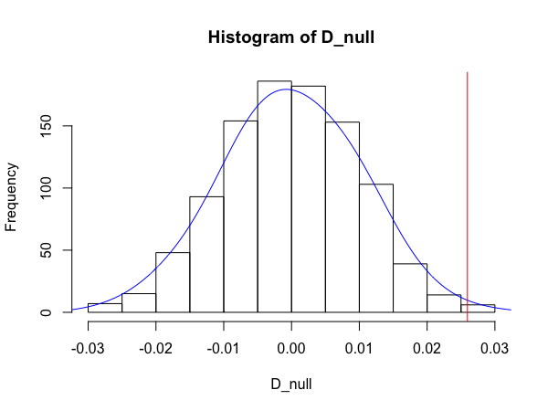
Soda + Fish
Purchasing soda & steak together has a permutation value of 0.004, which is below .05

Slide 4
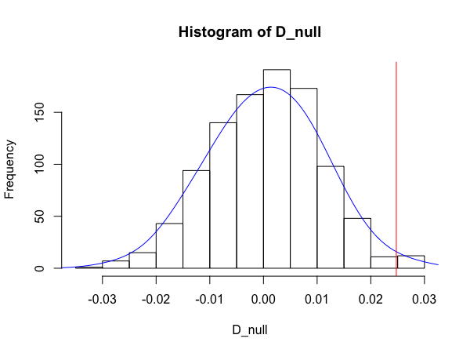
Soda + Cookies
Purchasing soda & steak together has a permutation value of 0.012, which is below .05

Slide 5
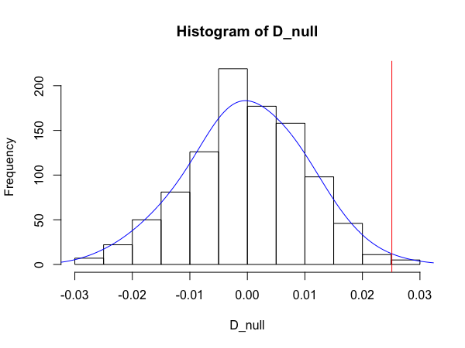
TEA + FISH
Purchasing soda & steak together has a permutation value of 0.005, which is below .05

Slide 6
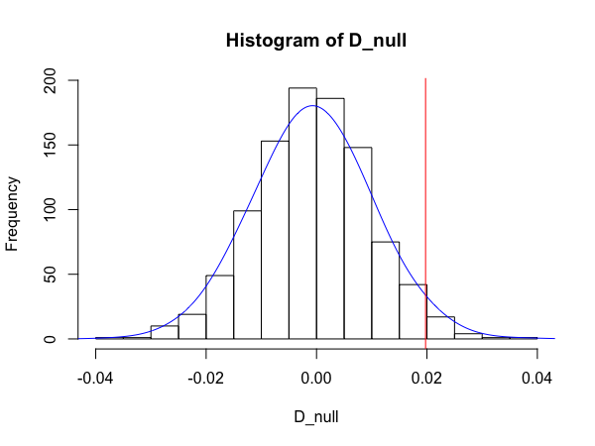
Steak + Salt
Purchasing soda & steak together has a permutation value of 0.025, which is below .05

Slide 7
Conclusion
From the p-values discovered it seems that soda is common complementary item.
Tea and Fish are apparently a good combo.
Steaks need salt.

